Slide 1
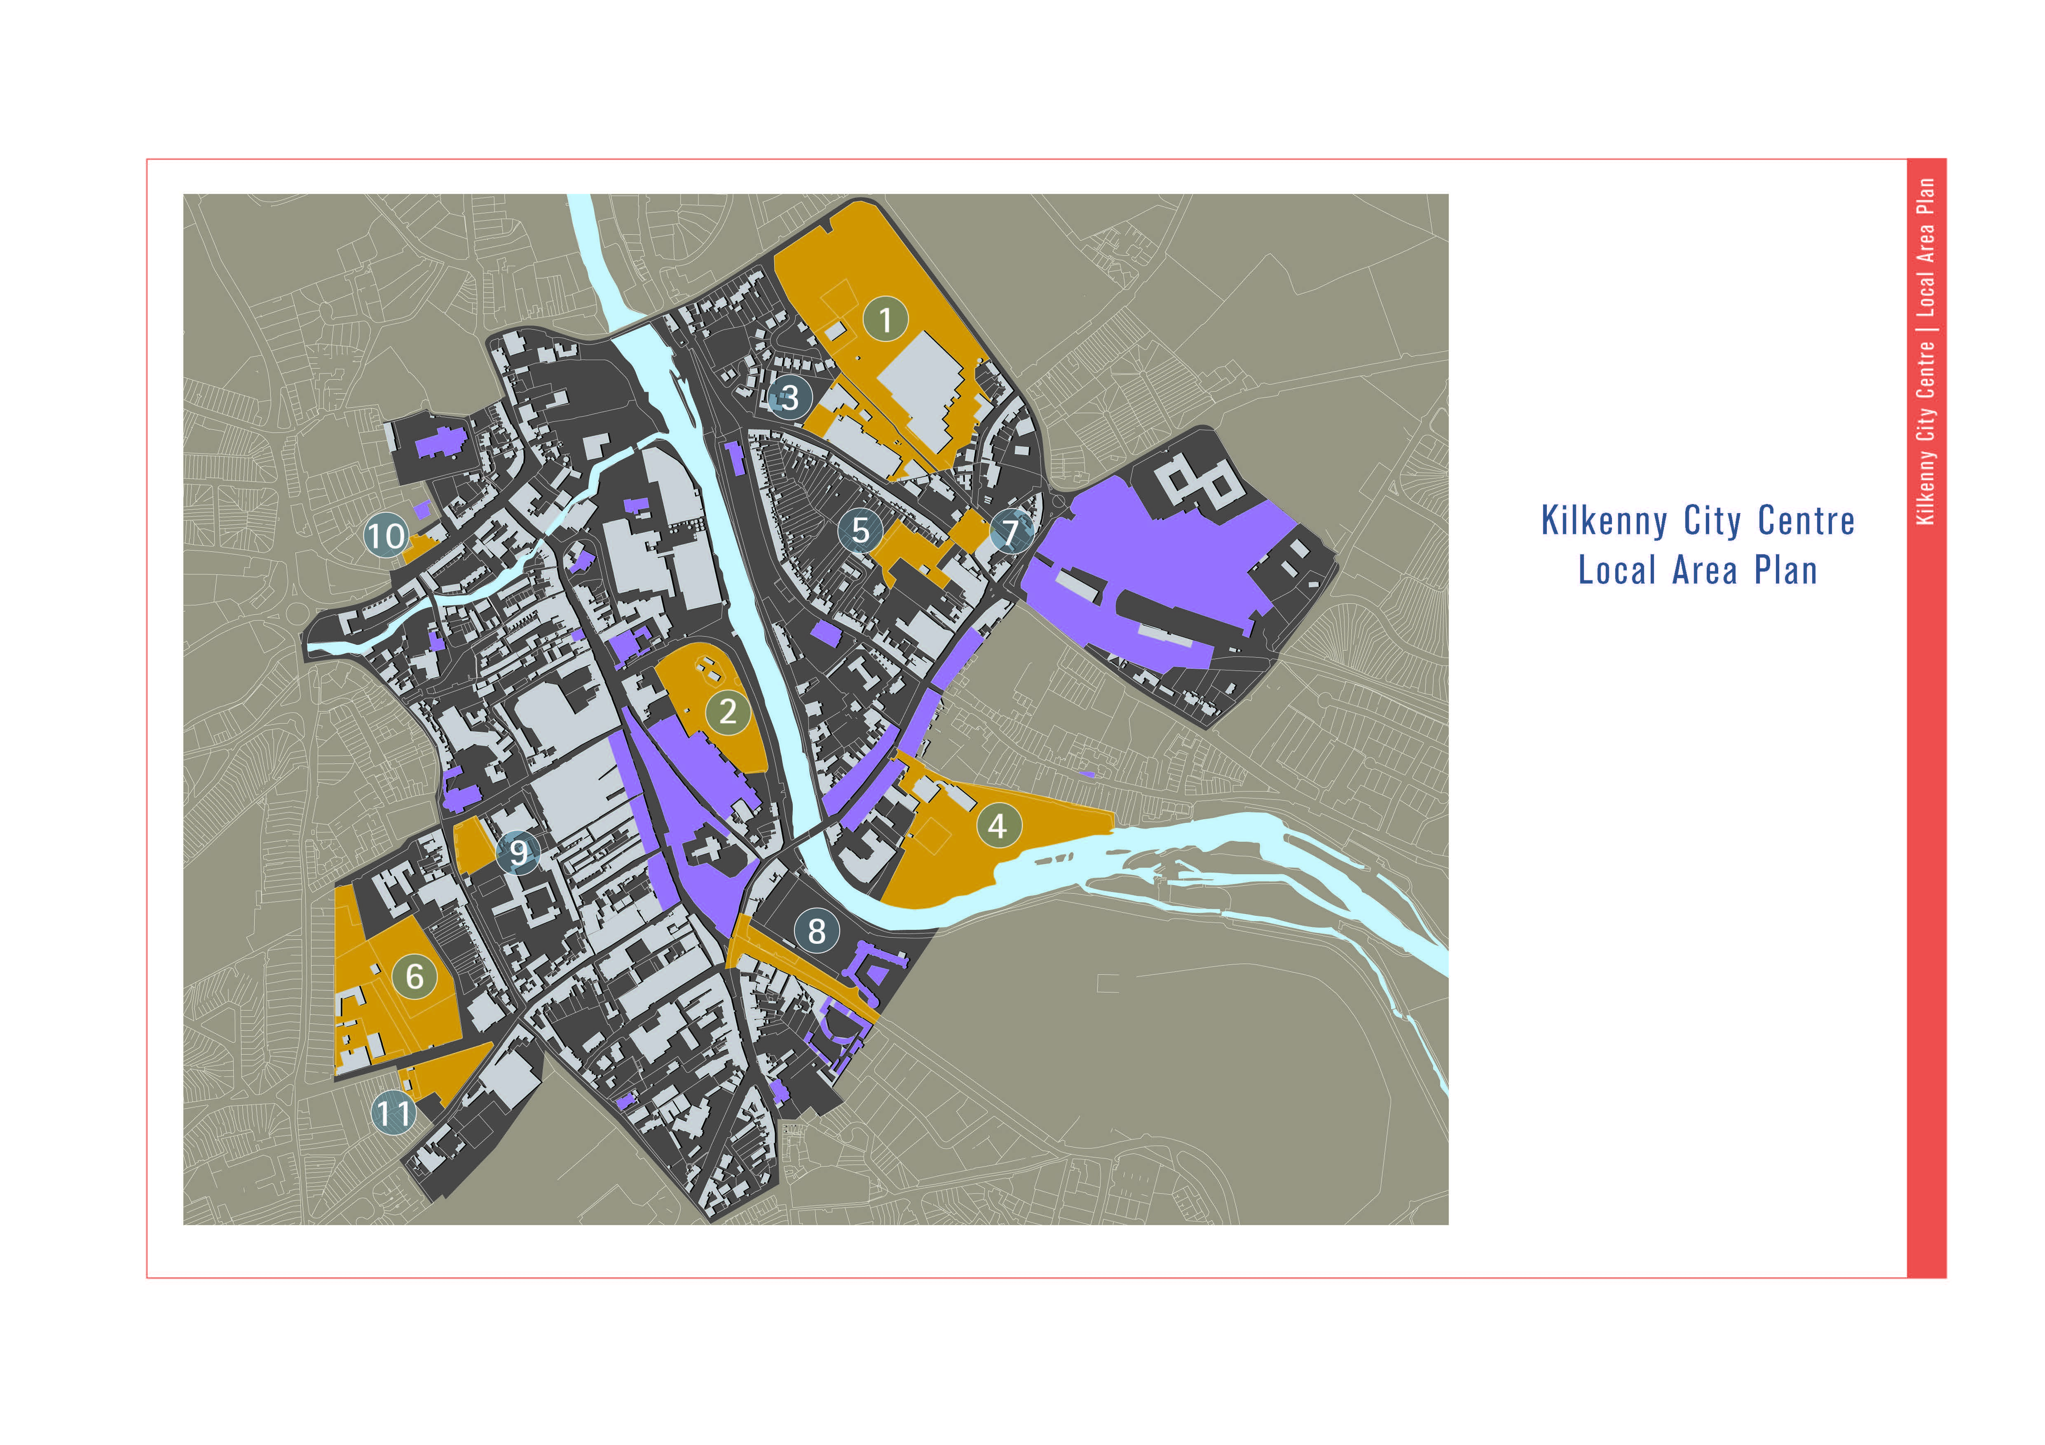
The Local Area Plan identified Key sites which needed redevelopment or enhancement.
The Diageo Site was omitted as it was hoped that Brewery would stay in business.

Slide 2
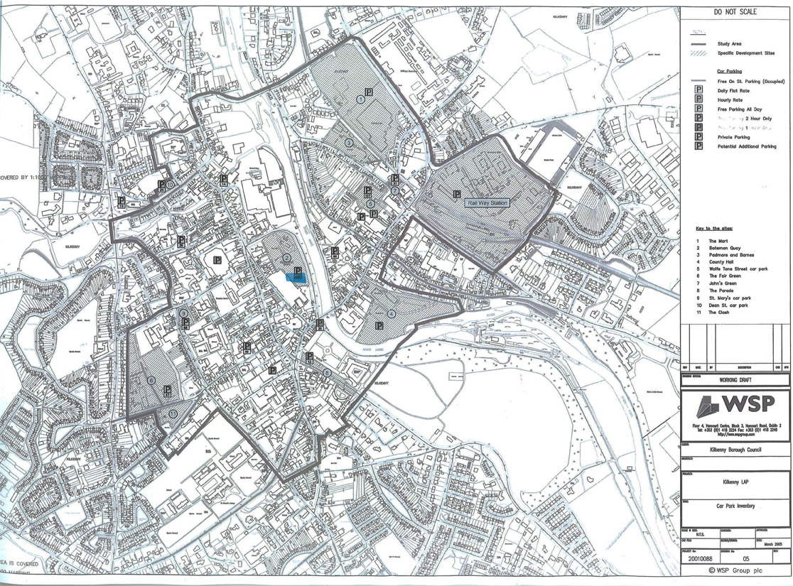
An inventory of current parking provision

Slide 3
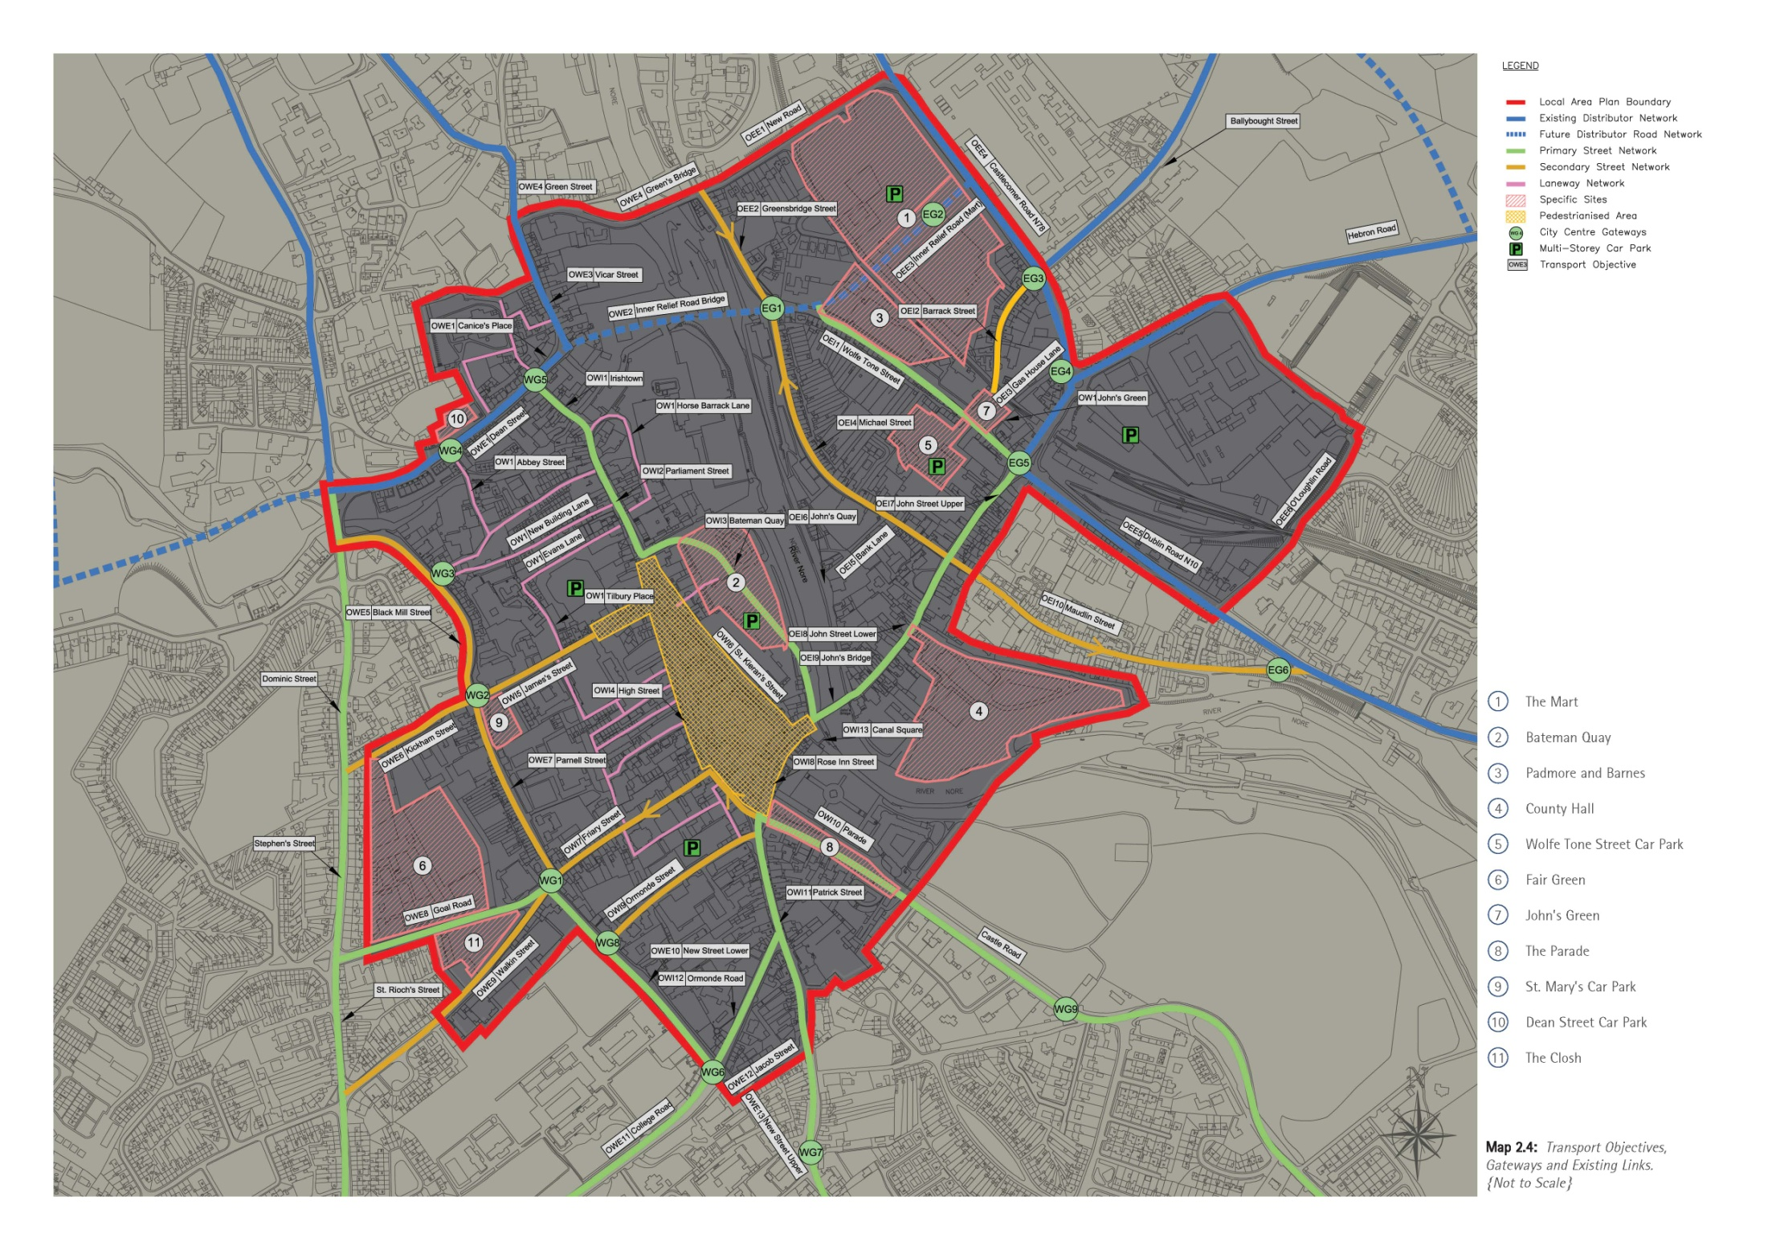
A strategy for street access and parking shows the intended Inner Relief Road across the Diageo Site

Slide 4
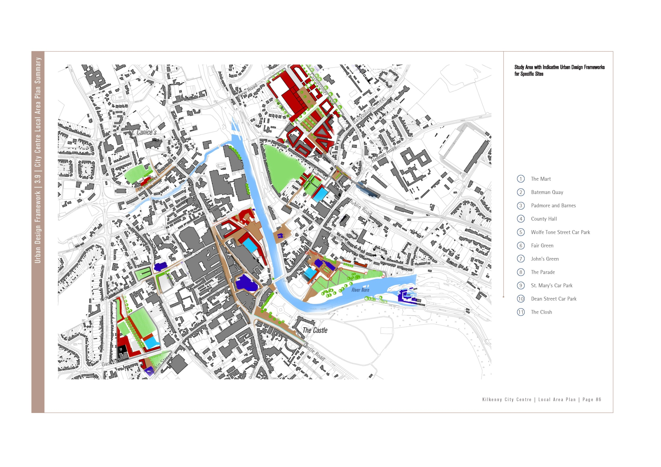
The specific sites with Urban Design Frameworks relevant to the Diageo Site are Bateman’s Quay, the Mart and
Padmore and Barnes, Wolfe Tone Street Car Park and John’s Green. Shown in more detail on next 3 pages

Slide 6
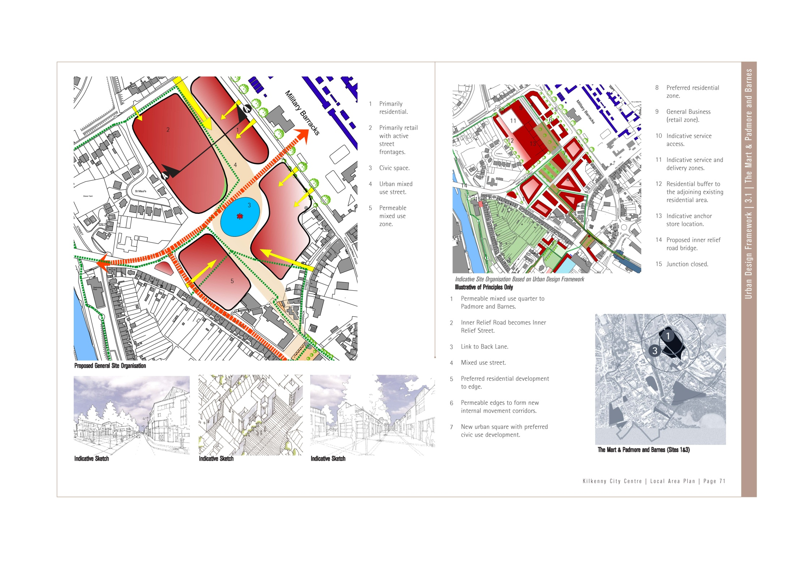

Slide 7
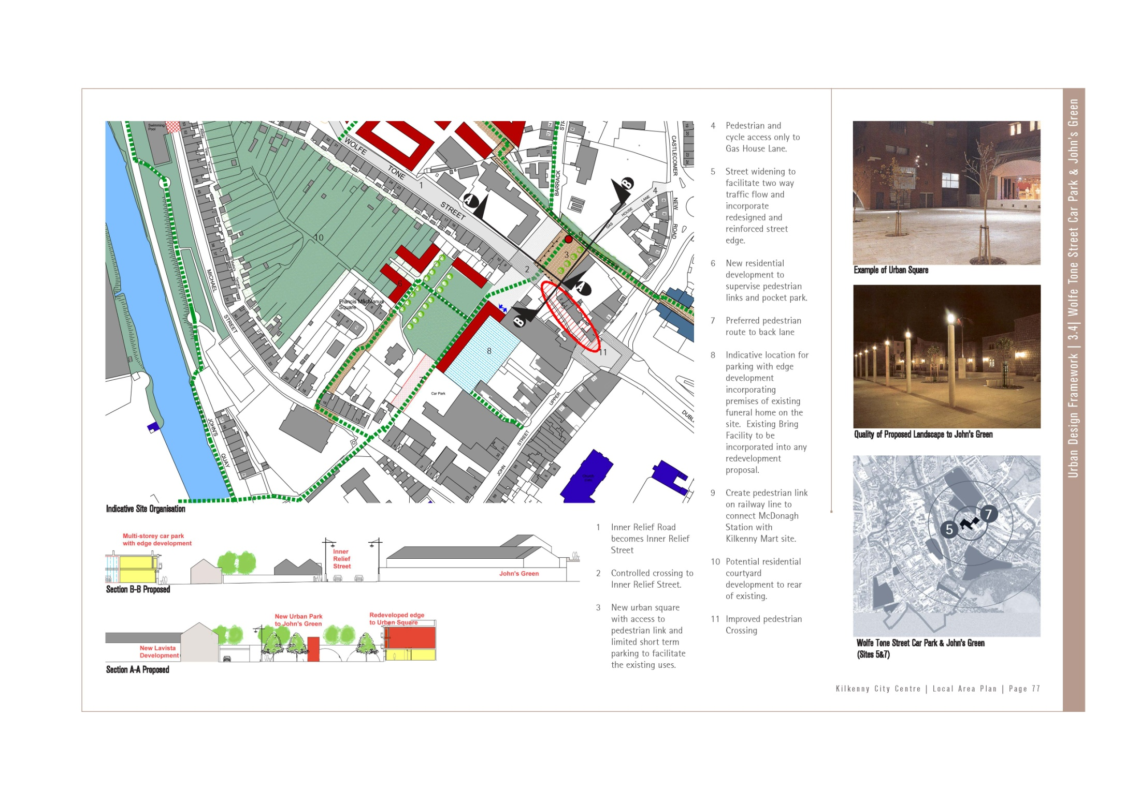

Slide 8
Inner Relief Road has become the Central Access Street
Sketch shows potential development of Diageo Site around the Nore Bridge

Slide 9
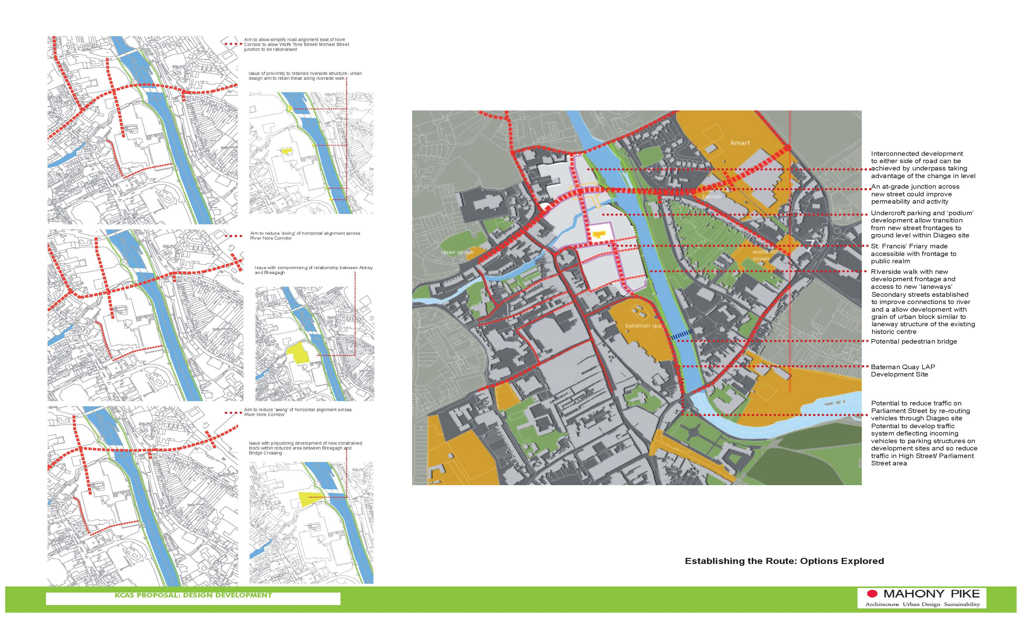
The Central Access Street now goes through the Mart Site

